Slide 1
Evaluating Functions From Graphs
College Algebra

Slide 2
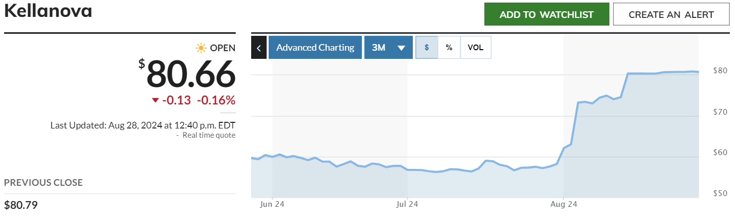
Example

Slide 3
Graphs – Pros and Cons
Pro: Can see overall trend in function values
Con: Not good for calculating specific function values
Graphs work best with tables or formulas

Slide 4
Example

Slide 5
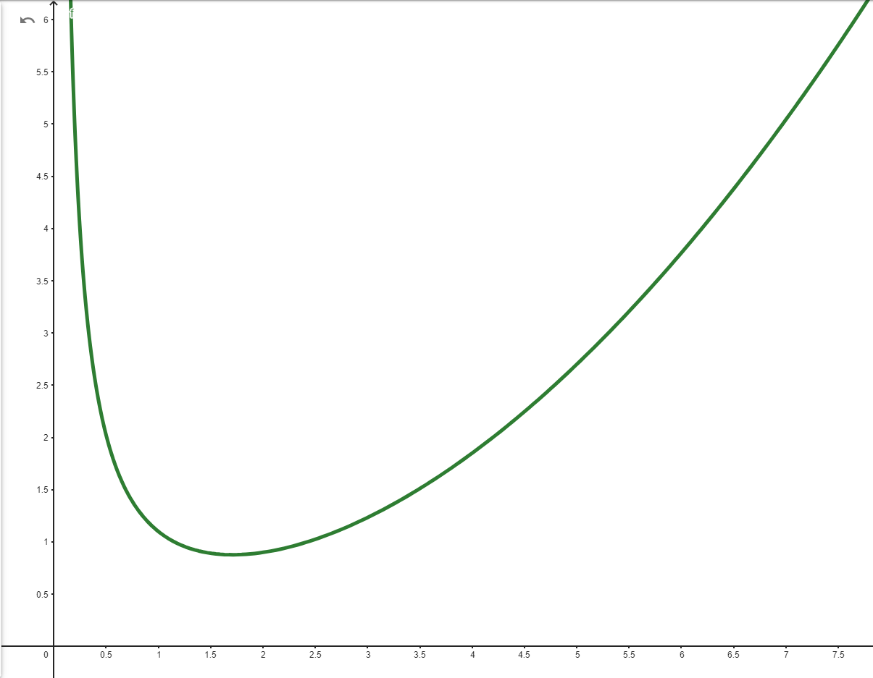
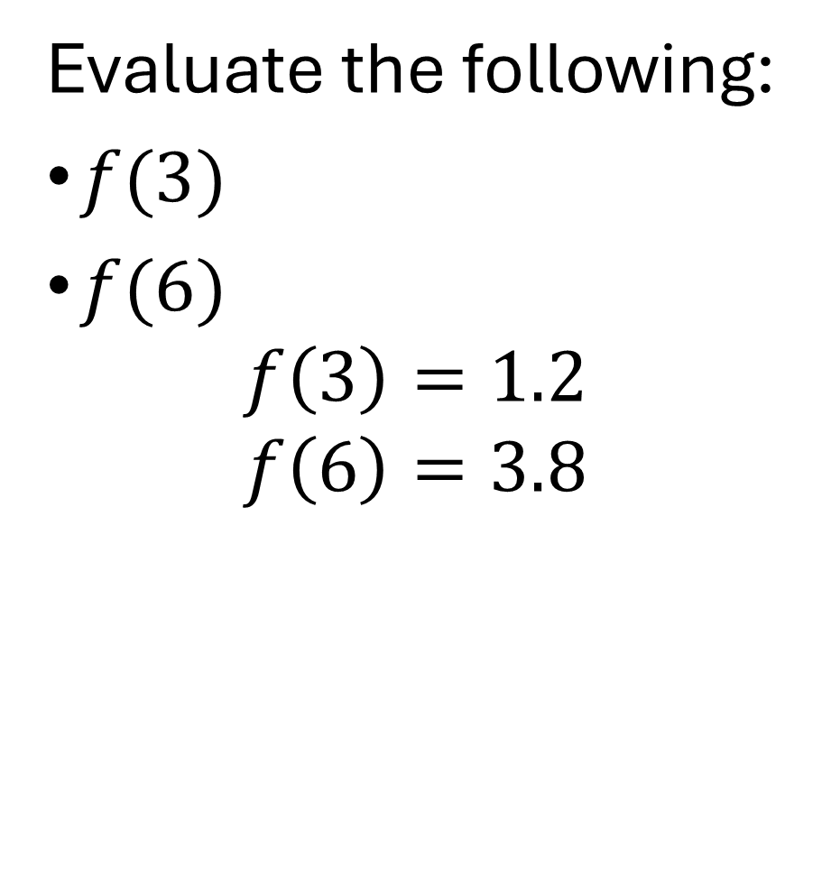
Example 1
Evaluate the following:
$f(3)$
$f(6)$
$$f\left(3\right)=1.2$$
$$f\left(6\right)=3.8$$

